Slide 1



Machine Learning
By Hall 2 It team

Slide 2
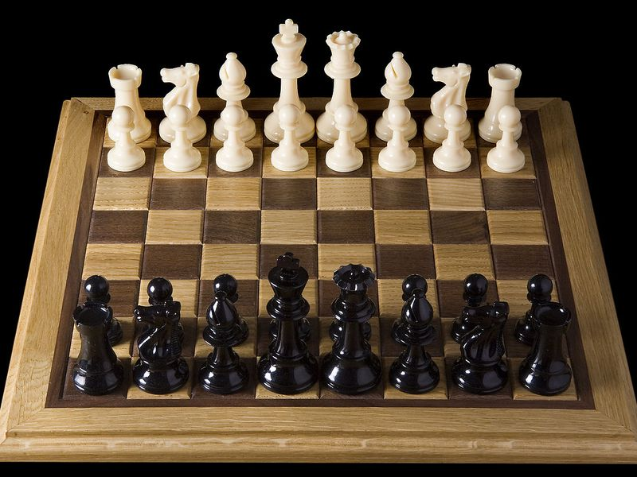

What is Machine Learning?
Tom Mitchell : "A computer program is said to learn from experience E, if its performance P at tasks in T, improves with experience E.“
Example: the computer gets better at recognizing digits as it sees more EXAMPLES, as measured by the ERROR rate.
Arthur Samuel, 1959: “Machine Learning is the field of study that gives computers the ability to learn without being explicitly programmed.
Example: computer learns to play chess by playing against itself.

Slide 3
Artificial Intelligence VS Machine Learning
ARTIFICIAL INTELLIGENCE
Can be a simple LOGICAL program to tell the computer what to do. For e.g. take input ‘x’ and ‘y’ and output ‘x + y’.
MACHINE LEARNING
Given some data with ‘x’ being the input and ‘y’ being the output, LEARN from that data in order to PREDICT the output ‘y’ in the future. For e.g. the ‘Size of the House’ can be the input and ‘Price of the House’ can be the output

Slide 4
Types of Machine Learning
Machine Learning
Unsupervised Learning
Supervised Learning
Reinforcement Learning

Slide 5
Supervised Learning
In supervised learning, we are given a data set that is LABELED and already know what the correct output should look like, having the idea that there is a relationship between the input and the output.
Example: Predicting Housing prices
Size (sq. feet) | No. of bedrooms | Price
2104 | 3 | 399900
1600 | 3 | 329900
2400 | 3 | 369000
1416 | 2 | 232000
3000 | 4 | 539900
1985 | 4 | 299900
1534 | 3 | 314900
1427 | 3 | 198999
1380 | 3 | 212000
1494 | 3 | 242500
1940 | 4 | 239999
2000 | 3 | 347000
Input (x)
Already known.
Output (y)

Slide 6

Supervised Learning
Dog
Cat
Dog
Can predict this image as a ‘Cat’.
Cat
Dog
Labeled Data Set
Cat

Slide 7



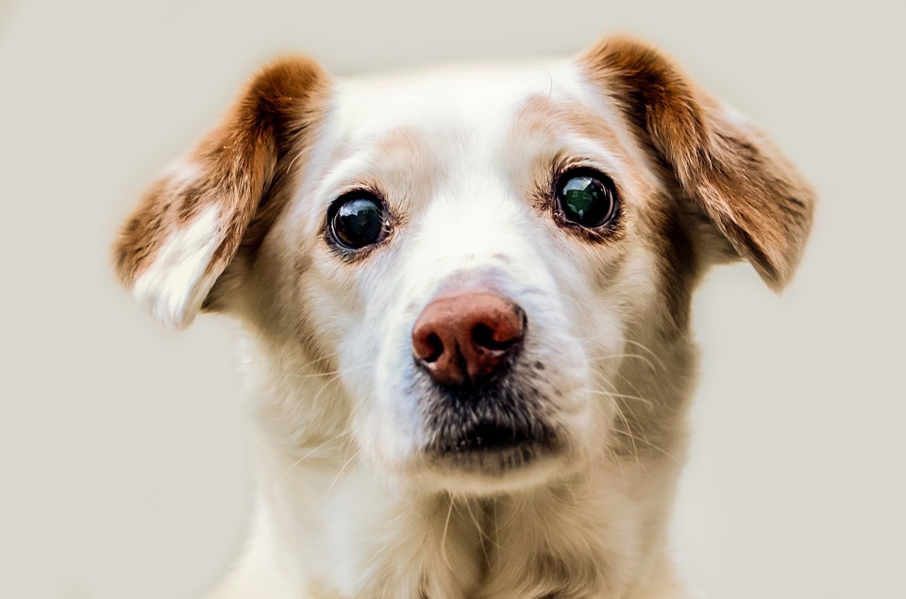


Unsupervised Learning
In Unsupervised learning, we have little or no idea what our results should look like. We can derive structure from UNLABELED data.
Dogs
Cats
Bundle them into 2 groups: ‘Cat’ and ‘Dog’
No Labels
Notes:
Clustering VS Non-Clustering?

Slide 8
Types of Machine Learning
Machine Learning
Unsupervised Learning
Supervised Learning
Reinforcement Learning
Regression problems
Classification Problems

Slide 9
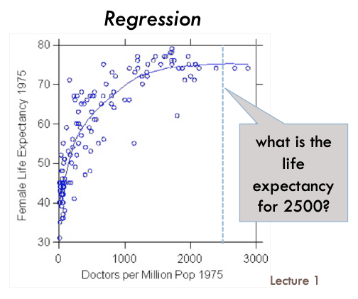
Regression Problems
In a regression problem, we are trying to predict results within a continuous output. For e.g. the housing prices can range from 10,000 to 100,000 with all the numbers (including decimals) in between therefore, continuous.
Copyright: CS4487- Dr. Antoni Chan

Slide 10
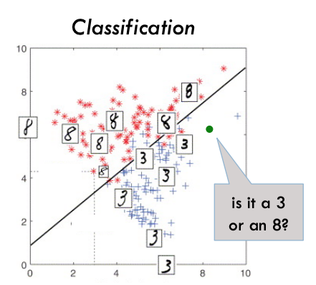
Classification Problems
In a classification problem, we are instead trying to predict results in a discrete output. For e.g. whether a house is too expensive or not with output being false (0) not expensive or true (1) expensive or medium (2) in between therefore, discrete.
Copyright: CS4487- Dr. Antoni Chan

Slide 11
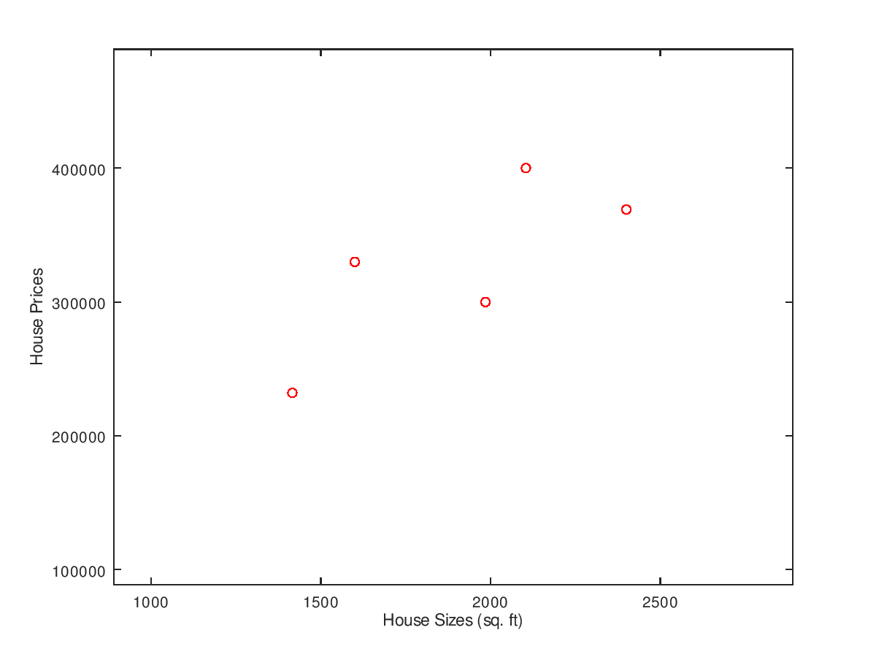
Linear Regression
Linear regression is one of the methods of how to fit a graph to the data.
Size (sq. feet) | Price
2104 | 399900
1600 | 329900
2400 | 369000
1416 | 232000
1534 | 314900
1985 | 299900
x_{i}
y_{i}
Graph plot

Slide 12
Linear Regression

Slide 13

Hypothesis Function
A function that will predict the value of output for us.
Hypothesis Function:
$$hθ\left(xi\right)= θ0+ θ1xi$$
Y = b + aX
Depending on different values of $θ0$ and $θ1$, we can have different hypothesis functions:

Slide 14


Cost Function
Function to calculate cost for choosing a certain value of $θ0$ and $θ1$
Cost function derivation:
(Predicted – Actual)
Cannot work because
(- 4 + 4 – 3 + 3) = 0
Cost = 0 means that all the Predicted Prices are equal to the Actual Prices which is not the case
To avoid this problem
(Predicted – Actual)²
Actual Price
(- 4) ² + (4) ² + (– 3) ² + (3) ² = 50
Take average to get the average cost
Costs
Predicted Price
$$\frac{1}{2m}\sum_{i=1}^{m}{{\left(h_{θ}\left(x_{i}\right)−y_{i}\right)}^{2},where m=entries in dataset}$$
$$or number of training sets$$

Slide 15
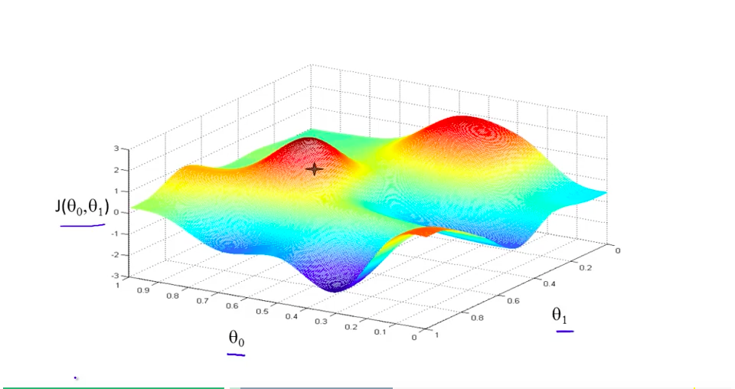

Predicting $θ0$and $θ1$
After getting Cost Function, we need a value of $θ0$ and $θ1$ such that it gives us a LEAST POSSIBLE cost of the Linear Regression.
Cost Function
One-Step Method
Iterative Method
Normal Equation
Gradient Descent
Copyright: Dr. Andrew Ng
Global Minimum

Slide 16
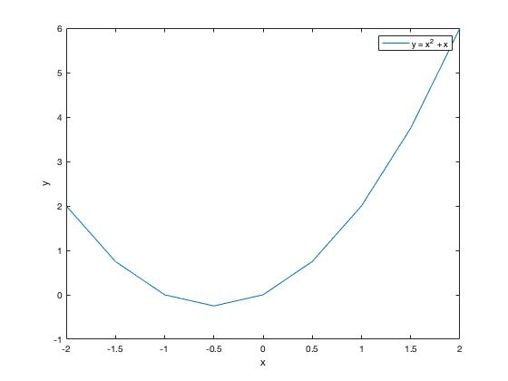

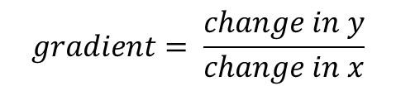


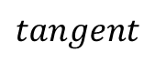



Getting a Minimum value of any Function (One-Step Method)
Minimum value of Y
$$gradient=0$$
$$\frac{dy}{dx}=0$$
$$gradient= \frac{change in y}{change in x}$$
$$x=−\frac{1}{2}$$
$$y=\frac{3}{4} (\min{value)}$$
$$2x+1=0$$
$$\frac{dy}{dx}$$
$$tangent$$

Slide 17



Normal Equation
Similarly, we apply the same concept to the Cost Function to get a value of $θ0$ and $θ1$ which gives us a Minimum Cost.
Calculate $\frac{d}{dθ_{0}}$ and $\frac{d}{dθ_{1}}$
Set both of them to 0
Solve to get the $θ0$ and $θ1$.
But, using matrices and after
some complex mathematical derivation:
$$where,$$
$$θ=\left(\begin{matrix}θ_{0} \\ θ_{1}\end{matrix}\right)$$
$$X=\left(\begin{matrix}1 & x_{1} \\ \begin{aligned}1 \\ ⋮ \\ 1\end{aligned} & \begin{aligned}x_{2} \\ ⋮ \\ x_{m}\end{aligned}\end{matrix}\right), one feature \& m training examples$$
$$T in{ X}^{T} means ′Transpose^{′}= \left(\begin{matrix}1 & \begin{matrix}1 & ⋯ & 1\end{matrix} \\ x_{1} & \begin{matrix}x_{2} & ⋯ & x_{m}\end{matrix}\end{matrix}\right)$$
$y$ = $\left({\begin{aligned}y_{1} \\ y_{2}\end{aligned} \atop \begin{aligned}⋮ \\ y_{m}\end{aligned}}\right)$
$$θ=(X^{T}X)^{−1}X^{T}y$$

Slide 18

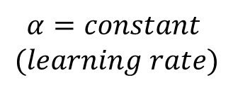

Getting a Minimum value of any Function (Iterative Method)
Take a tangent at the starting point
Calculate $\frac{dy}{dx}$(gradient)
Randomly selected starting x
$$α=constant$$
$$(learning rate)$$
$$x=x − α\frac{dy}{dx}$$
Since gradient is positive at this point, value of x will decrease.
Desired optimal x which gives min y
Repeat the previous step few times until x reaches the desired optimal value that we want
Because the gradient will be 0 at that point, x will stop changing

Slide 19
Getting a Minimum value of any Function (Iterative Method)
Take a tangent at the starting point
Calculate $\frac{dy}{dx}$(gradient)
Another randomly selected starting x
$$x=x − α\frac{dy}{dx}$$
Since gradient is NEGATIVE at this point, value of x will INCREASE.
Repeat the previous step few times until x reaches the desired value that we want
Because the gradient will be 0 at that point, x will stop changing
Desired x which gives min y

Slide 20

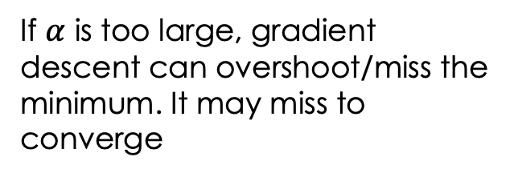
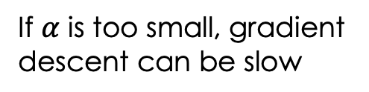
Choosing learning rate $α$
If $α$ is too large, gradient descent can overshoot/miss the minimum. It may miss to converge
If $α$ is too small, gradient descent can be slow

Slide 21



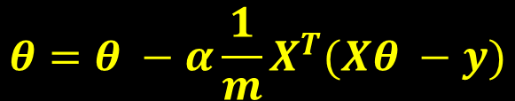


Gradient Descent
Similarly, we apply the same concept to $θ0$ and $θ1$ to get a Minimum Cost.
Calculate $\frac{d}{dθ_{0}}$ and $\frac{d}{dθ_{1}}$
Choose $learning rate α$
Perform these operations iteratively
until it stops changing:
$θ0=θ0− α\frac{d}{dθ0}$ ,
$$θ1=θ1− α\frac{d}{dθ1}$$
$$where,$$
$$θ=\left(\begin{matrix}θ_{0} \\ θ_{1}\end{matrix}\right)$$
$$X=\left(\begin{matrix}1 & x_{1} \\ \begin{aligned}1 \\ ⋮ \\ 1\end{aligned} & \begin{aligned}x_{2} \\ ⋮ \\ x_{m}\end{aligned}\end{matrix}\right), one feature \& m training examples$$
$$T in{ X}^{T} means ′Transpose^{′}= \left(\begin{matrix}1 & \begin{matrix}1 & ⋯ & 1\end{matrix} \\ x_{1} & \begin{matrix}x_{2} & ⋯ & x_{m}\end{matrix}\end{matrix}\right)$$
$y$ = $\left({\begin{aligned}y_{1} \\ y_{2}\end{aligned} \atop \begin{aligned}⋮ \\ y_{m}\end{aligned}}\right)$
$$repeat until convergence:\{$$
$$θ0=θ0− α\frac{1}{m}\sum_{i=1}^{m}{\left(h_{θ}\left(x_{i}\right)−y_{i}\right)}$$
$$θ1=θ1− α\frac{1}{m}\sum_{i=1}^{m}{({\left(h_{θ}\left(x_{i}\right)−y_{i}\right)x}_{i})}$$
$$θ=θ −α\frac{1}{m}X^{T}(Xθ −y)$$
$$\}$$

Slide 22
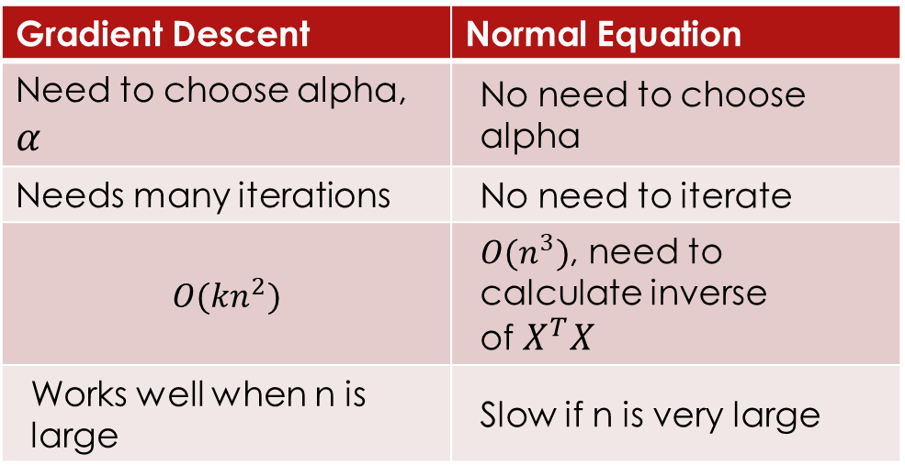
Gradient Descent VS Normal Equation
Gradient Descent | Normal Equation
Need to choose alpha, $α$ | No need to choose alpha
Needs many iterations | No need to iterate
$$O(kn^{2})$$ | $O(n^{3})$, need to calculate inverse of $X^{T}X$
Works well when n is large | Slow if n is very large
If we have a very large number of features, the normal equation will be slow. In practice, when n exceeds 10,000 it might be a good time to go from a normal solution to an iterative process.

Slide 23

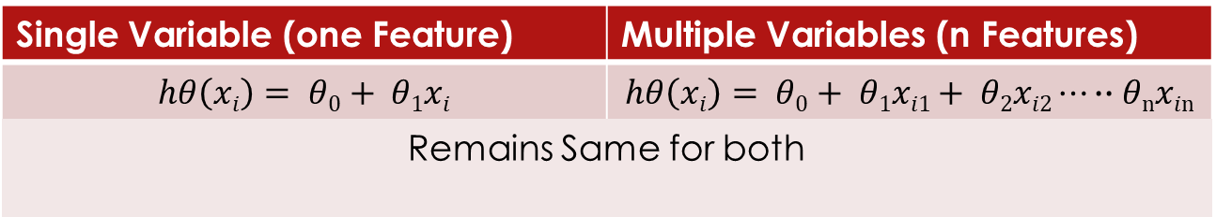


Linear Regression with Multiple Variables
Single Variable (one Feature) | Multiple Variables (n Features)
$$hθ\left(xi\right)= θ0+ θ1xi$$ | $$hθ\left(xi\right)= θ0+ θ1xi1+ θ2xi2⋯∙∙θnxin$$
Remains Same for both
Hypothesis Function:
Cost Function, Normal Equation, Gradient Descent:
$$where,$$
$$θ=\left(\begin{matrix}θ_{0} \\ \begin{aligned}θ_{1} \\ ⋮ \\ θ_{n}\end{aligned}\end{matrix}\right)$$
$$X= \left(\begin{aligned}1 \\ 1 \\ ⋮ \\ 1\end{aligned} \begin{matrix}x_{11} \\ x_{12} \\ \begin{aligned}⋮ \\ x_{1m}\end{aligned}\end{matrix}\begin{matrix}x_{21} \\ x_{22} \\ \begin{aligned}⋮ \\ x_{2m}\end{aligned}\end{matrix}⋯\left.\begin{aligned}x_{n1} \\ x_{n2} \\ ⋮ \\ x_{nm}\end{aligned}\right)\right., n features \& m training examples$$
$y$ = $\left({\begin{aligned}y_{1} \\ y_{2}\end{aligned} \atop \begin{aligned}⋮ \\ y_{m}\end{aligned}}\right)$
$$Normal Equation: θ=(X^{T}X)^{−1}X^{T}y$$
$$Gradient Descent: θ=θ −α\frac{1}{m}X^{T}(Xθ −y)$$

Slide 24

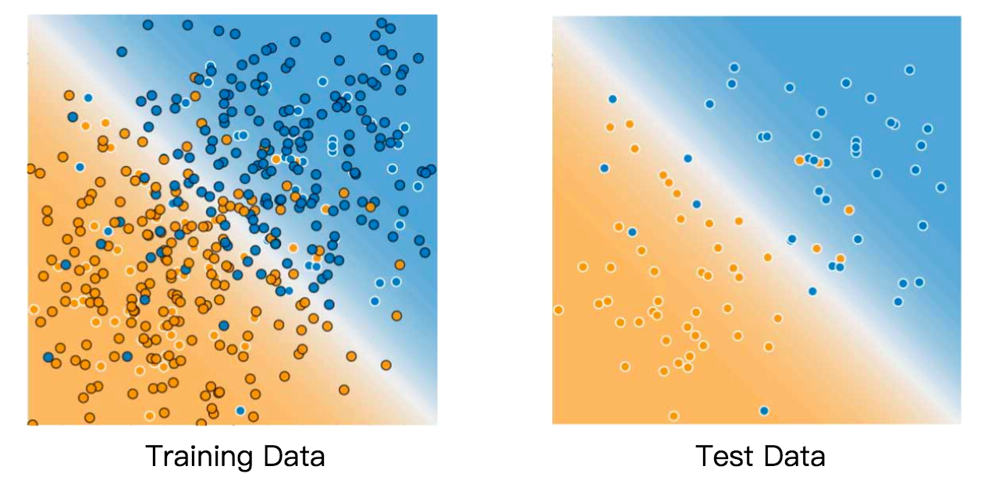
Practical Implementation
Now that we have learned some basic concepts, let’s try to see how to Machine Learning practically.
Separating data set
Requirements for the test data set
Is large enough to yield statistically meaningful results.
Is representative of the data set as a whole. In other words, don't pick a test set with different characteristics than the training set.

Slide 25
Introduction to some basic libraries
Numpy Library
the fundamental package for scientific computing with Python
Combine and split arrays, add and remove elements, describe statistics, doing maths
Panda Library (structures and analysis)
one of the most preferred and widely used tools in data munging/wrangling
it takes data (like a CSV or TSV file, or a SQL database) and creates a Python object with rows and columns called data frame that looks very similar to table in a statistical software
Matplotlib Library
create 2D/3D plots with just a few commands
Scikit Learn Library
modeling data
E.g. select and extract features, identify meaningful attributes

Slide 26

Hands-on Assignment
Go to this link: https://github.com/cityu-hall2/MachineLearningWorkshop2018
Download Anaconda
Download the assignment materials to Desktop from the “Assignment” folder.
Open Anaconda Navigator and launch ‘Jupyter Notebook’
Open the ‘assignment_blank.ipynb’.

Slide 27

PRESENTED BY PROSPERITY HALL(HALL 2) IT TEAM
Thank you and keep on learning!
Please fill out this feedback form!

